Slide 1
File Systems
Abhijit A M
abhijit.comp@coep.ac.in

Slide 2
System calls related to files/file-system
Open(2), chmod(2), chown(2), close(2), dup(2), fcntl(2), link(2), lseek(2), mknod(2), mmap(2), mount(2), read(2), stat(2), umask(2), unlink(2), write(2), fstat(2), access(2), readlink(2), ...

Slide 3
Implementing file systems

Slide 4
File system on disk
Disk I/O in terms of sectors (512 bytes)
File system: implementation of acyclic graph using the linear sequence of sectors
Device driver: available to rest of the OS code to access disk using a block number

Slide 5

File system implementation: layering

Slide 6
Application programs
int main() {
char buf[128]; int count;
fd = open(...):
read(fd, buf, count);
}
-----
OS
Logical file system:
sys_read(int fd, char *buf, int count) {
file *fp = currproc->fdarray[fd];
file_read(fp, ...);
}
File organization module:
file_read(file *fp, char *buf, int count) {
offset = fp->current-offset;
translate offset into blockno;
basic_read(blockno, buf, count);
}
Basic File system:
basic_read(int blockno, char *buf, ...) {
os_buffer *bp;
sectorno = calculation on blockno;
disk_driver_read(sectono, bp );
move-process-to-wait-queue;
copy-data-to-user-buffer(bp, buf);
}
IO Control, Device driver:
disk_driver_read(sectorno) {
issue instructions to disk controller (often assembly code)
to read sectorno into specific location;
}
XV6 does it slightely differently, but following the layering principle!

Slide 7

A typical file control block (inode)
Why does it NOT contain the
Name of the file ?

Slide 8
Disk space allocation for files
File contain data and need disk blocks/sectors for storing it
File system layer does the allocation of blocks on disk to files
Files need to
  Be created, expanded, deleted, shrunk, etc.
  How to accommodate these requirements?

Slide 9

Contiguous Allocation of Disk Space

Slide 10
Contiguous allocation
Each file occupies set of contiguous blocks
Best performance in most cases
Simple – only starting location (block #) and length (number of blocks) are required
Problems include finding space for file, knowing file size, external fragmentation, need for compaction off-line (downtime) or on-line

Slide 11

Linked allocation of blocks to a file

Slide 12
Linked allocation of blocks to a file
Linked allocation
  Each file a linked list of blocks
  File ends at nil pointer
  No external fragmentation
  Each block contains pointer to next block (i.e. data + pointer to next block)
  No compaction, external fragmentation
  Free space management system called when new block needed
  Improve efficiency by clustering blocks into groups but increases internal fragmentation
  Reliability can be a problem
  Locating a block can take many I/Os and disk seeks

Slide 13

FAT: File Allocation Table
FAT (File Allocation Table), a variation
  Beginning of volume has table, indexed by block number
  Much like a linked list, but faster on disk and cacheable
  New block allocation simple

Slide 14

FAT: File Allocation Table
Variants: FAT8, FAT12, FAT16, FAT32, VFAT, ...

Slide 15

Indexed allocation

Slide 16
Indexed allocation
Need index table
Random access
Dynamic access without external fragmentation, but have overhead of index block
Mapping from logical to physical in a file of maximum size of 256K bytes and block size of 512 bytes. We need only 1 block for index table

Slide 17
Multi level indexing
outer-index
index table
file

Slide 18

Unix UFS: combined scheme for block allocation

Slide 19
Free Space Management
File system maintains free-space list to track available blocks/clusters
  Bit vector or bit map (n blocks)
  Or Linked list

Slide 20
Free Space Management: bit vector
Each block is represented by 1 bit.
If the block is free, the bit is 1; if the block is allocated, the bit is 0.
  For example, consider a disk where blocks 2, 3, 4, 5, 8, 9, 10, 11, 12, 13, 17
  18, 25, 26, and 27 are free and the rest of the blocks are allocated. The free-space bitmap would be 001111001111110001100000011100000 ...
A 1- TB disk with 4- KB blocks would require 32 MB (2⁴⁰ / 2¹² = 2²⁸ bits = 2²⁵ bytes = 2⁵ MB) to store its bitmap

Slide 21

Free Space Management: Linked list (not in memory, on disk!)

Slide 22
Further improvements on link list method of free-blocks
Grouping
Counting
Space Maps (ZFS)
Read as homework

Slide 23
Directory Implementation
Problem
  Directory contains files and/or subdirectories
  Operations required – create files/directories, access files/directories, search for a file (during lookup), etc.
  Directory needs to give location of each file on disk

Slide 24
Directory Implementation
Linear list of file names with pointer to the data blocks
  Simple to program
  Time-consuming to execute
    Linear search time
    Could keep ordered alphabetically via linked list or use B+ tree
  Ext2 improves upon this approach.
Hash Table – linear list with hash data structure
  Decreases directory search time
  Collisions – situations where two file names hash to the same location
  Only good if entries are fixed size, or use chained-overflow method

Slide 25
Ext2 FS layout

Slide 26

Ext2 FS Layout

Slide 27
struct ext2_super_block {
__le32 s_inodes_count; /* Inodes count */
__le32 s_blocks_count; /* Blocks count */
__le32 s_r_blocks_count; /* Reserved blocks count */
__le32 s_free_blocks_count; /* Free blocks count */
__le32 s_free_inodes_count; /* Free inodes count */
__le32 s_first_data_block; /* First Data Block */
__le32 s_log_block_size; /* Block size */
__le32 s_log_frag_size; /* Fragment size */
__le32 s_blocks_per_group; /* # Blocks per group */
__le32 s_frags_per_group; /* # Fragments per group */
__le32 s_inodes_per_group; /* # Inodes per group */
__le32 s_mtime; /* Mount time */
__le32 s_wtime; /* Write time */
__le16 s_mnt_count; /* Mount count */
__le16 s_max_mnt_count; /* Maximal mount count */
__le16 s_magic; /* Magic signature */
__le16 s_state; /* File system state */
__le16 s_errors; /* Behaviour when detecting errors */

Slide 28
struct ext2_super_block {
...
__le16 s_minor_rev_level; /* minor revision level */
__le32 s_lastcheck; /* time of last check */
__le32 s_checkinterval; /* max. time between checks */
__le32 s_creator_os; /* OS */
__le32 s_rev_level; /* Revision level */
__le16 s_def_resuid; /* Default uid for reserved blocks */
__le16 s_def_resgid; /* Default gid for reserved blocks */
__le32 s_first_ino; /* First non-reserved inode */
__le16 s_inode_size; /* size of inode structure */
__le16 s_block_group_nr; /* block group # of this superblock */
__le32 s_feature_compat; /* compatible feature set */
__le32 s_feature_incompat; /* incompatible feature set */
__le32 s_feature_ro_compat; /* readonly-compatible feature set */
__u8 s_uuid[16]; /* 128-bit uuid for volume */
char s_volume_name[16]; /* volume name */
char s_last_mounted[64]; /* directory where last mounted */
__le32 s_algorithm_usage_bitmap; /* For compression */

Slide 29
struct ext2_super_block {
...
__u8 s_prealloc_blocks; /* Nr of blocks to try to preallocate*/
__u8 s_prealloc_dir_blocks; /* Nr to preallocate for dirs */
__u16 s_padding1;
/*
* Journaling support valid if EXT3_FEATURE_COMPAT_HAS_JOURNAL set.
*/
__u8 s_journal_uuid[16]; /* uuid of journal superblock */
__u32 s_journal_inum; /* inode number of journal file */
__u32 s_journal_dev; /* device number of journal file */
__u32 s_last_orphan; /* start of list of inodes to delete */
__u32 s_hash_seed[4]; /* HTREE hash seed */
__u8 s_def_hash_version; /* Default hash version to use */
__u8 s_reserved_char_pad;
__u16 s_reserved_word_pad;
__le32 s_default_mount_opts;
__le32 s_first_meta_bg; /* First metablock block group */
__u32 s_reserved[190]; /* Padding to the end of the block */

Slide 30
struct ext2_group_desc
{
__le32 bg_block_bitmap; /* Blocks bitmap block */
__le32 bg_inode_bitmap; /* Inodes bitmap block */
__le32 bg_inode_table; /* Inodes table block */
__le16 bg_free_blocks_count; /* Free blocks count */
__le16 bg_free_inodes_count; /* Free inodes count */
__le16 bg_used_dirs_count; /* Directories count */
__le16 bg_pad;
__le32 bg_reserved[3];
};

Slide 31
struct ext2_inode {
__le16 i_mode; /* File mode */
__le16 i_uid; /* Low 16 bits of Owner Uid */
__le32 i_size; /* Size in bytes */
__le32 i_atime; /* Access time */
__le32 i_ctime; /* Creation time */
__le32 i_mtime; /* Modification time */
__le32 i_dtime; /* Deletion Time */
__le16 i_gid; /* Low 16 bits of Group Id */
__le16 i_links_count; /* Links count */
__le32 i_blocks; /* Blocks count */
__le32 i_flags; /* File flags */

Slide 32

Inode in ext2

Slide 33
struct ext2_inode {
...
union {
struct {
__le32 l_i_reserved1;
} linux1;
struct {
__le32 h_i_translator;
} hurd1;
struct {
__le32 m_i_reserved1;
} masix1;
} osd1; /* OS dependent 1 */
__le32 i_block[EXT2_N_BLOCKS];/* Pointers to blocks */
__le32 i_generation; /* File version (for NFS) */
__le32 i_file_acl; /* File ACL */
__le32 i_dir_acl; /* Directory ACL */
__le32 i_faddr; /* Fragment address */

Slide 34
struct ext2_inode {
...
union {
struct {
__u8 l_i_frag; /* Fragment number */ __u8 l_i_fsize; /* Fragment size */
__u16 i_pad1; __le16 l_i_uid_high; /* these 2 fields */
__le16 l_i_gid_high; /* were reserved2[0] */
__u32 l_i_reserved2;
} linux2;
struct {
__u8 h_i_frag; /* Fragment number */ __u8 h_i_fsize; /* Fragment size */
__le16 h_i_mode_high; __le16 h_i_uid_high;
__le16 h_i_gid_high;
__le32 h_i_author;
} hurd2;
struct {
__u8 m_i_frag; /* Fragment number */ __u8 m_i_fsize; /* Fragment size */
__u16 m_pad1; __u32 m_i_reserved2[2];
} masix2;
} osd2; /* OS dependent 2 */

Slide 35

Ext2 FS Layout: Directory entry

Slide 36
Let’s see a program to read superblock of an ext2 file system.

Slide 37
Efficiency and Performance
(and the risks created
while trying to achieve it!)

Slide 38
In memory data structures
Mount table
  storing file system mounts, mount points, file system types
See next slide for “file” realated data structures
Buffers
  hold data blocks from secondary storage

Slide 39

In memory data structures: for open,read,write, ...
Open returns a file handle for subsequent use
Data from read eventually copied to specified user process memory address

Slide 40
Efficiency
Efficiency dependent on:
  Disk allocation and directory algorithms
  Types of data kept in file’s directory entry
  Pre-allocation or as-needed allocation of metadata structures
  Fixed-size or varying-size data structures

Slide 41
Performance
Keeping data and metadata close together
Buffer cache – separate section of main memory for frequently used blocks
Synchronous writes sometimes requested by apps or needed by OS
No buffering / caching – writes must hit disk before acknowledgement
Asynchronous writes more common, buffer-able, faster
Free-behind and read-ahead – techniques to optimize sequential access
Reads frequently slower than writes

Slide 42
Page cache
A page cache caches pages rather than disk blocks using virtual memory techniques and addresses
Memory-mapped I/O uses a page cache
Routine I/O through the file system uses the buffer (disk) cache
This leads to the following figure

Slide 43
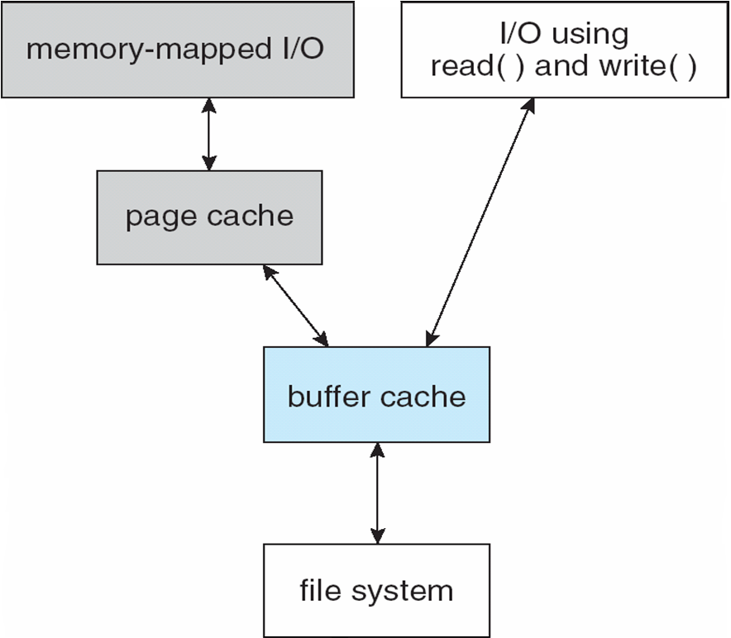
I/O Without a Unified Buffer Cache

Slide 44
Unified buffer cache
A unified buffer cache uses the same page cache to cache both memory-mapped pages and ordinary file system I/O to avoid double caching
But which caches get priority, and what replacement algorithms to use?

Slide 45
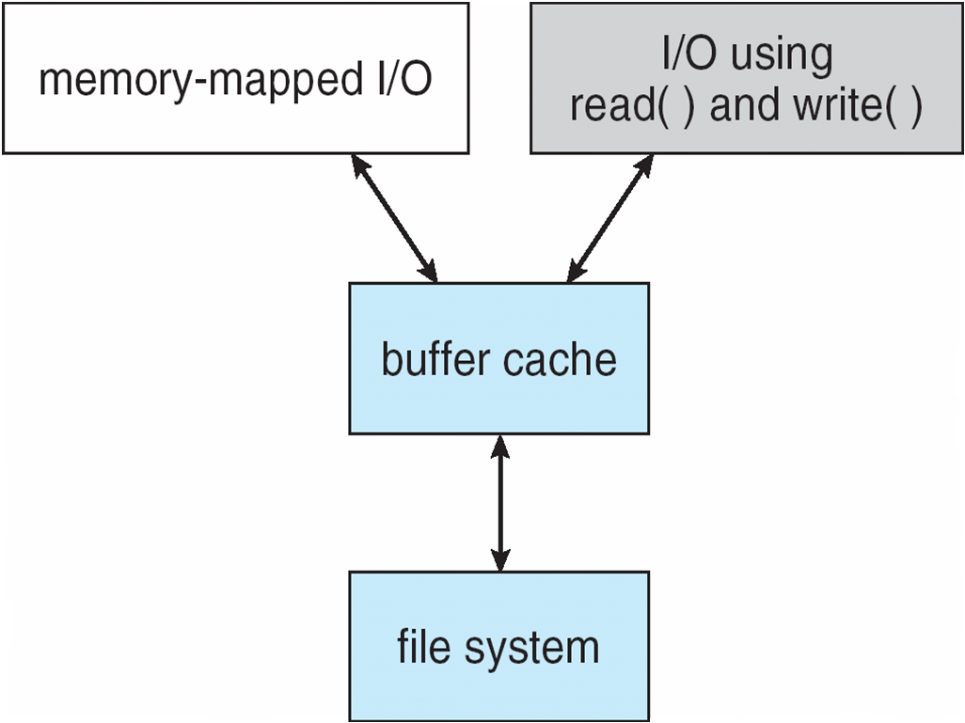
I/O Using a Unified Buffer Cache

Slide 46
Recovery
Problem. Consider creating a file on ext2 file system.
  Following on disk data structures will/may get modified
  Directory data block, new directory data block, block bitmap, inode table, inode table bitmap, group descriptor, super block, data blocks for new file, more data block bitmaps, ...
  All cached in memory by OS
Delayed write – OS writes changes in its in-memory data structures, and schedules writes to disk when convenient
  Possible that some of the above changes are written, but some are not
  Inconsistent data structure! --> Example: inode table written, inode bitmap written, but directory data block not written

Slide 47
Recovery
Consistency checking – compares data in directory structure with data blocks on disk, and tries to fix inconsistencies
  Can be slow and sometimes fails
Use system programs to back up data from disk to another storage device (magnetic tape, other magnetic disk, optical)
Recover lost file or disk by restoring data from backup

Slide 48
Log structured file systems
Log structured (or journaling) file systems record each metadata update to the file system as a transaction
All transactions are written to a log
  A transaction is considered committed once it is written to the log (sequentially)
  Sometimes to a separate device or section of disk
  However, the file system may not yet be updated
The transactions in the log are asynchronously written to the file system structures
  When the file system structures are modified, the transaction is removed from the log
If the file system crashes, all remaining transactions in the log must still be performed
Faster recovery from crash, removes chance of inconsistency of metadata

Slide 49
Journaling file systems
Veritas FS
Ext3, Ext4
Xv6 file system!

